Slide 1

Introduction to Grafana
Made by Amr Ibrahim

Slide 2
Table of Content
What is observability
Grafana Stack
Grafana Agent
Open Telemetry
Visualization type in Grafana
Alerts
Users and permissions

Slide 3
What is observability (O11Y)
is the ability to measure the internal states of a system by examining its outputs
A system is considered “observable” if the current state can be estimated by only using information from outputs, namely sensor data
Three are three types of data (metrics , Logs , Traces)
Metrics refer to something is happening (ex: CPU is high or Error rates)
Logs refer to what’s happening (ex: logs of why app is down)
Traces refer to where is this happening (ex: which API take much time)

Slide 4
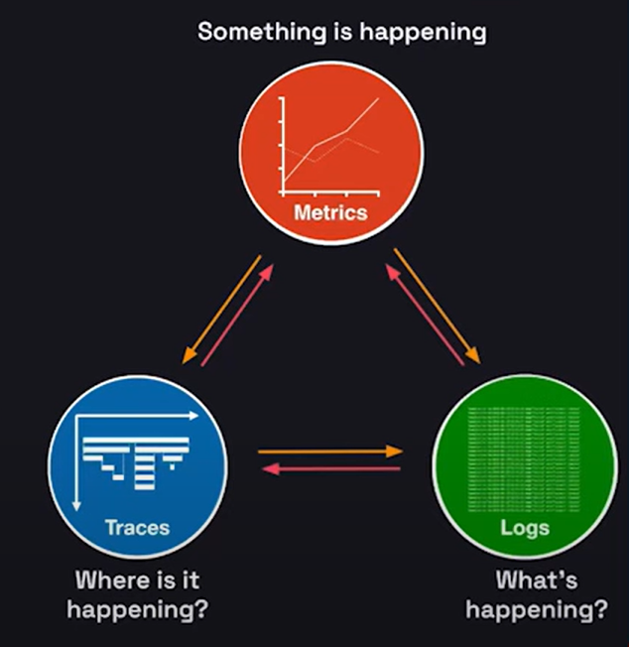
Cont. observability

Slide 5
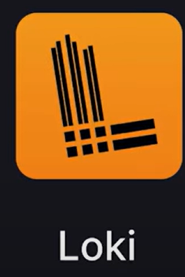
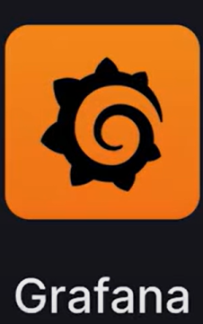
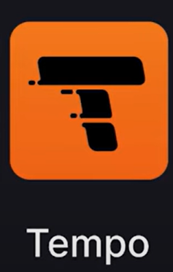
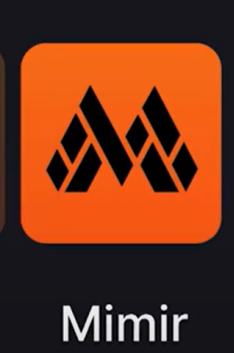
Grafana Stack

Slide 6
Cont. Grafana Stack
We can integrate different data sources like Prometheus , Redis , etc.
We can send notification based on metrics
We can use Grafana self hosted , Cloud based or enterprise one.

Slide 7
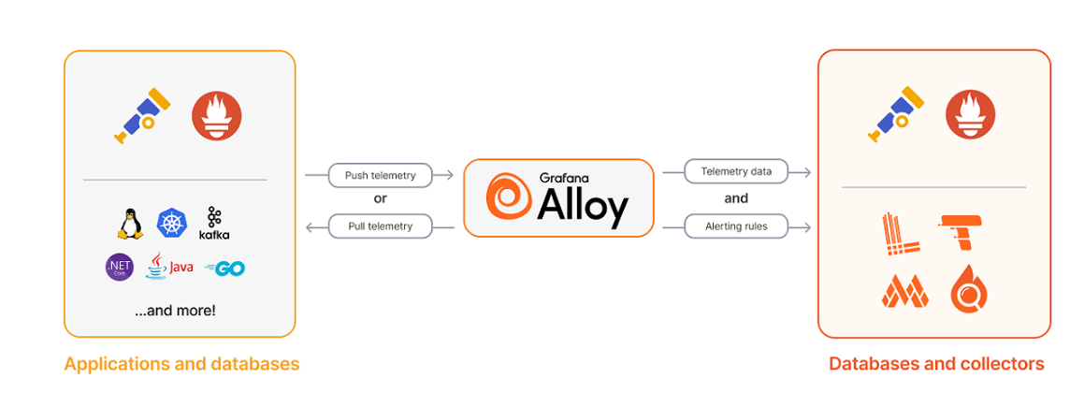
Grafana Agent (Alloy)
Alloy is a flexible, high performance, vendor-neutral distribution of the OpenTelemetry Collector. It’s fully compatible with the most popular open-source observability standards such as Open Telemetry and Prometheus.
Alloy Collect data , transform the data then write it to Grafana stack

Slide 8
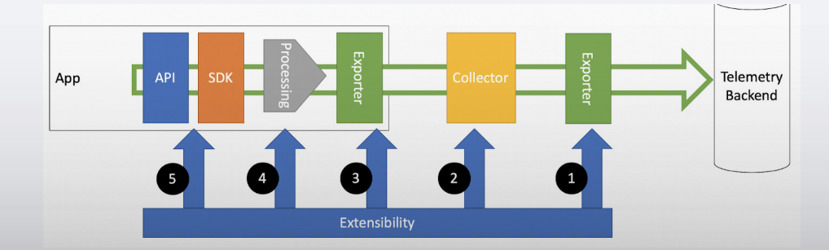
What is Open Telemetry
OpenTelemetry is an open-source Observability framework that standardizes the collection and analysis of telemetry data such as traces, metrics and logs across diverse software environments. It provides a unified approach to Observability by supporting multiple programming languages, frameworks, and platforms.
Open telemetry used OTEL protocol

Slide 9
Developer Side
Logs : if the logs already to stdout or log files No code change needed
Metrics : we need to expose application metrics in Prometheus format (/metrics) common libraries python (prometheus_client) , Node.js (prom-client)
Traces: you need to instrument your code using an Open Telemetry SDK: python (opentelemetry-sdk) , Node.js (@opentelemetry/sdk-node)
There are two types on instrument automatic and manual

Slide 10
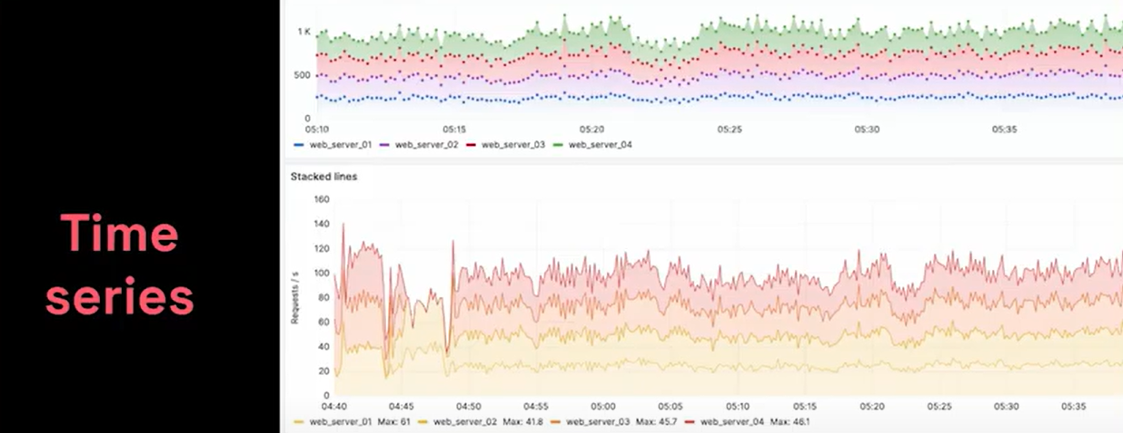
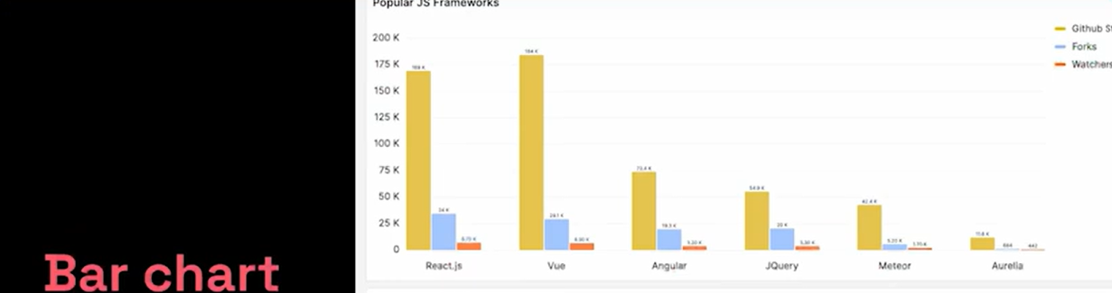
Visualization Types

Slide 11
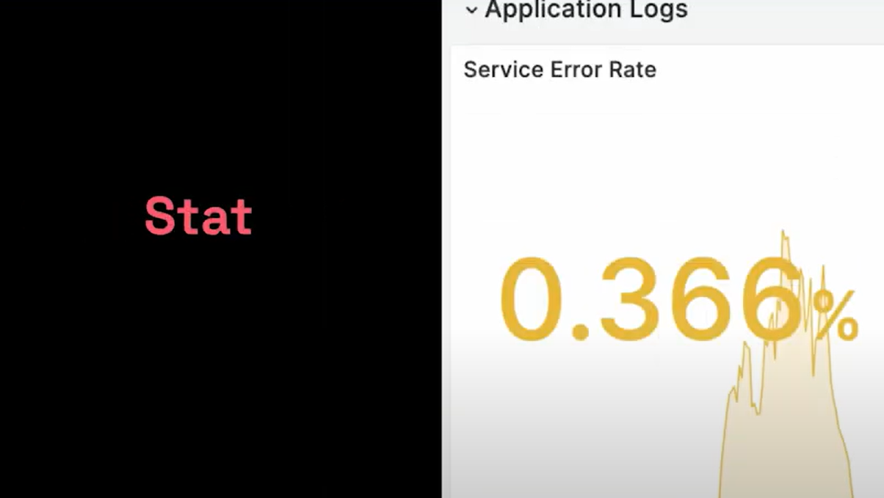
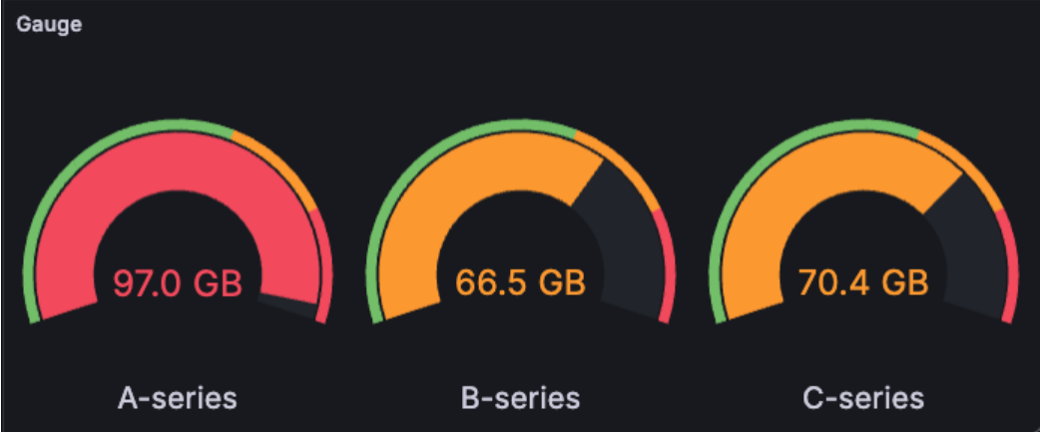
Visualization Types

Slide 12
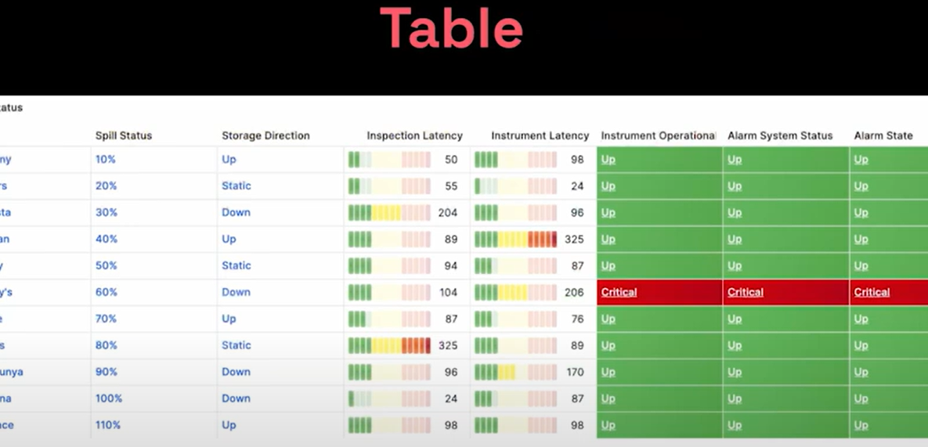
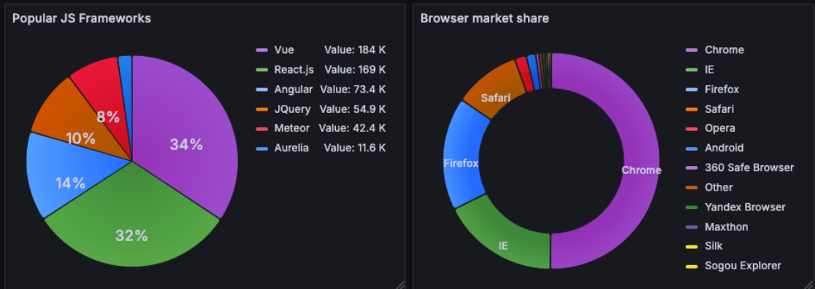
Visualization Types

Slide 13
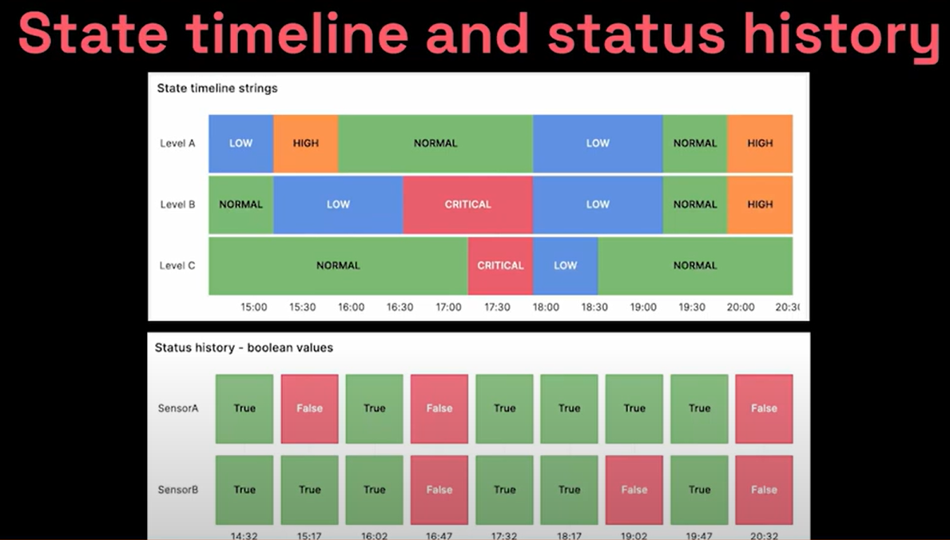
Visualization Types

Slide 14
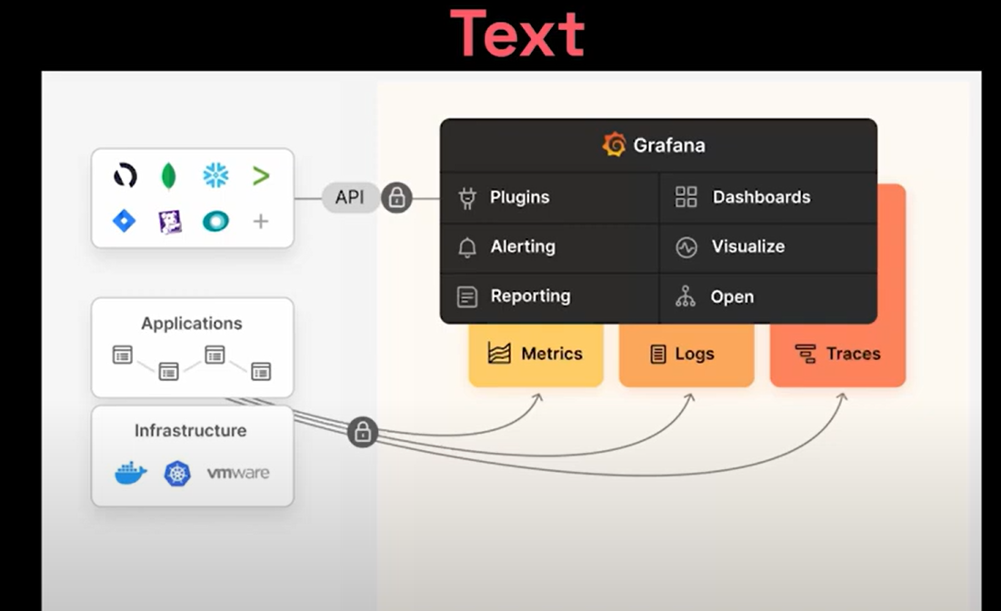
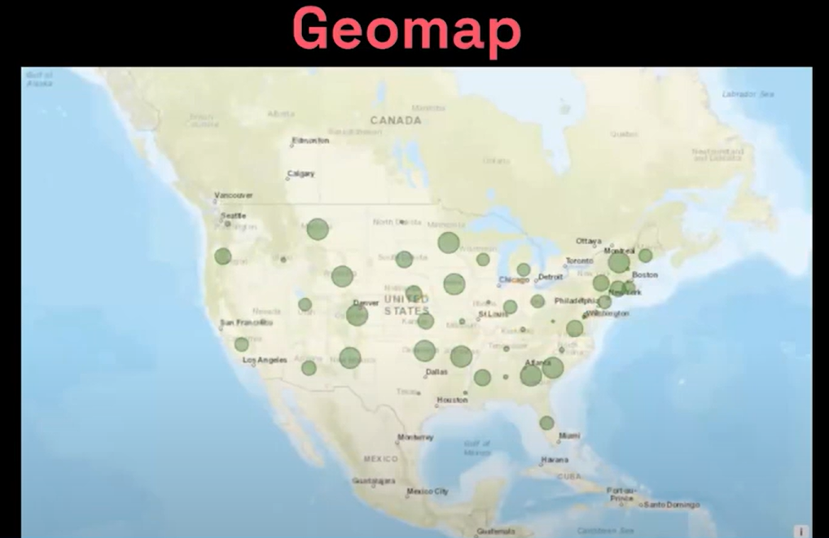
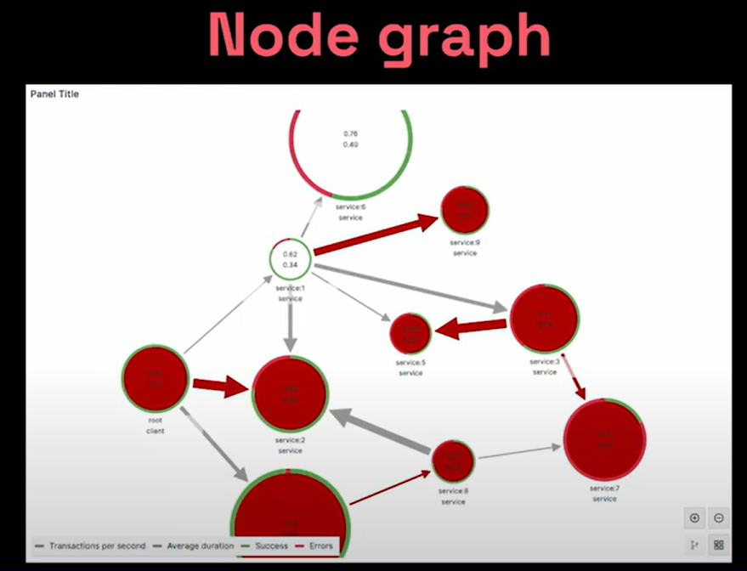
Visualization Types

Slide 15
Grafana Alerts
Create
You can create alerts based on rules and certain condition threshold
Contact
Contact points : where the alerts where send
Send
Notification policies : mean which alert will send to which contact point

Slide 16
User and Permissions
An organization is an entity that helps you isolate users and resources such as dashboards, annotations, and data sources from each others.
You can invite members based on organization (Viewer , Editor , admin)
You can also create Team and give access from dashboard
Team is a group of members share the same permission

Slide 17
Thanks

